Slide 1
Descriptive statistics and Probability
Introduction to Statistics

Slide 2
Agenda
Descriptive Statistics
Introduction to Probability
Probability
Odds
Independence of Events
Conditional Probability
Bayes Theorem

Slide 3

Statistics
Statistics
Descriptive Statistics
Inferential Statistics
It is used to only describe the sample or summarize information about the sample
It is used to make inferences and generalizations about the broader population

Slide 4
Descriptive Statistics

Slide 5
Descriptive Statistics
Descriptive statistics is the term given to the analysis of the data that helps describe, visualize or summarize the data
Descriptive Statistics
Measures of Central Tendency
Distribution of the Data
Measures of Dispersion

Slide 6
Measures of central tendency
A measure of central tendency is a single value that identifies the central position of the data
Measure of Central Tendency | Description | Example
Mean | Ratio of sum of all observations to the number of observations | price = [1, 2, 3, 4, 5] mean = 3
Median | Middle most observation in the data when it is arranged either in ascending or descending order of their values | price = [6, 8, 9, 18, 20] median = 9
Mode | Value which has the highest frequency | price = [6, 18, 9, 18, 20] mode = 18

Slide 7
Measures of central tendency
Measure of Central Tendency | Description
Partition values | The values that divide the data into desired number of equal parts
Quartiles | The values that divide the data into four equal parts

Slide 8
Measures of dispersion
The measure of dispersion refers to the variability within the data where variability is the measure of how close or far the data lie from the central value
Measures of Dispersion | Description | Example
Range | The difference between the largest and smallest value in the data | price = [1, 2, 3, 4, 5] range = 4
Variance | The arithmetic mean of squares of deviations taken from the mean | price = [6, 18, 9, 18, 20] variance = 31.36
Standard deviation | The square root of variance | price = [6, 18, 9, 18, 20] Std deviation = 5.6

Slide 9
Measures of dispersion
Measures of Dispersion | Description
Coefficient of variation | A relative measure of deviation, it is the ratio of standard deviation to the mean
Interquartile Range | The difference between the first and the third quartile

Slide 10
Skewness and kurtosis
 | Description
Skewness | Lack of symmetry or departure from symmetry
Kurtosis | Measures the peakedness of the distribution. In other words, defines how the tails of the distribution differ from the normal distribution

Slide 11
Covariance and correlation
 | Description
Covariance | Tells whether two variable are related or not and gives the direction of the relationship (positive/negative)
Correlation | Tells whether two variable are related and along with the direction of the relationship (positive/negative), it tells how strong the relationship is

Slide 12
Introduction to Probability

Slide 13

Experiment
An experiment is procedure that can be repeated umpteenth times, having a set of possible outcomes.
For example:
The result of rolling a die is either 1 or 2 or 3 or 4 or 5 or 6
Measuring height of a person
The result of tossing a coin is either head or tail

Slide 14
Trial of an experiment
A trial of an experiment is performing the experiment once
‘n’ trials imply the experiment is performed ‘n’ times
Trials can either be sequential or simultaneous

Slide 15
Experiment
Experiment
Based on the number of outcomes of an experiment
Deterministic Experiment
Random Experiment
Only one possible outcome and can be predicted in advance
For instance,
Experiment: Heating water to 100˚C
Outcome: Water turns to vapour
More than one possible outcomes and can not be predicted in advance
For instance,
Experiment: Returns on an investment
Outcomes: More, less, no change

Slide 16
Probability

Slide 17

Probability
Probability is a measure for the likelihood of occurrence of an event
The probability of any event lies in between 0 to 1
The sum of all possible events of an experiment is 1
Probability of an event A is denoted by P(A)

Slide 18
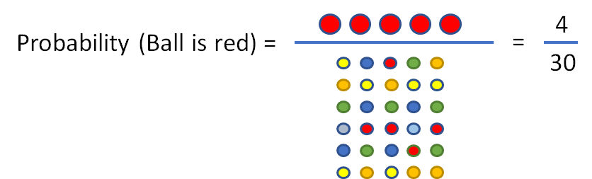
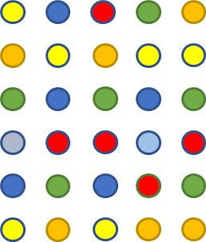
Probability
All possible outcomes

Slide 19
Probability of complement of an event A is 1 - P(A)
Probability of an impossible event is 0, i.e. P(Φ) = 0
For any event B, 0 ≤ P(B) ≤ 1
If event A is a subset of event B (A ⊂ B), then P(A) ≤ P(B)

Slide 20
Probability
Question:
The new vaccine is to be tested on several patients. There are 5 diabetic patients with same type of diabetes, 9 non-diabetic patients with same heart condition and 11 non-diabetic patients with same liver condition. One patient is randomly chosen. What is the probability that the patient is not diabetic?

Slide 21
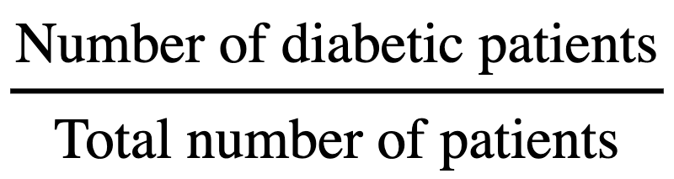
Probability
Solution:
Let A: event that a patient is chosen
Total number of patients = 5 + 9 + 11 = 25
Number of diabetic patients = 5
Probability that a diabetic patients is chosen, i.e. P(A) =

Slide 22
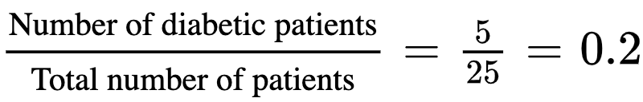
Probability
Solution:
P(A) =
The required probability is the a diabetic patients is not chosen, i.e P(A’)
P(A’) = 1 - P(A) = 1- 0.2 = 0.8

Slide 23
Odds

Slide 24

Odds
Odds of an event is the ratio of the number of observations in favour of an event to the number of observations not in favour of the event
Probability is sometimes expressed in terms of odds

Slide 25
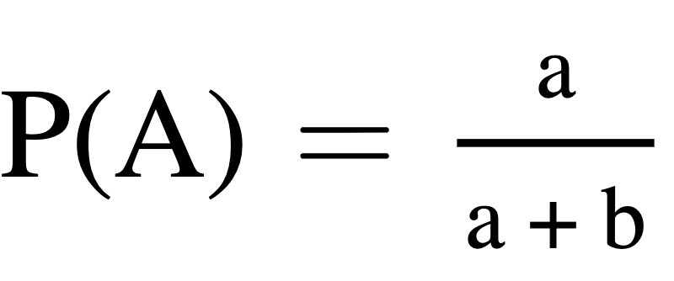
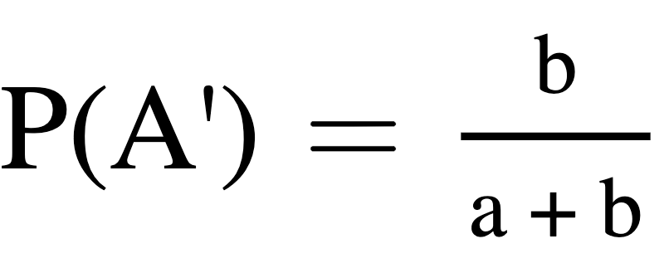

Odds
Odds in favour of an event A are a:b
Odds against an event A are a:b

Slide 26
Odds
Question:
The odds that a New Yorker picked at random will be either overweight or obese are 14:11. What is the probability that the person is fit (is not overweight or obese)?

Slide 27
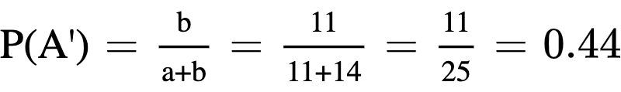
Odds
Solution:
Let A: a New Yorker is obese
The odds in favour of A are 14:11
Here, a = 14 and b = 11
The probability that the person is fit (is not overweight or obese) is 1-P(A) = P(A’)

Slide 28

Summary
Probability of an event is the ratio of number of observations in favour of an event to all possible observations
Odds of an event is the ratio of number of observations in favour of an event to number of observations not in favour of the event

Slide 29
Independence of Events

Slide 30
Independence of Events
Let A and B be two events, they are said to be independent if occurrence or non-occurrence of one event does not affect the occurence of others
Events A and B, are said to be independent if P(A ⋂ B) = P(A) . P(B)
The results hold vice versa. For two events A and B if P(A ⋂ B) = P(A) . P(B), then the events A and B are independent

Slide 31

Independent event
Question:
Consider rolling a fair die. Let events A and B be:
A: Occurrence of an odd prime number
B: Occurrence of a number greater than 3
Are the events A and B independent? Why.

Slide 32
Independent event
Solution:
Here the events are:
A: Occurrence of an odd prime number
B: Occurrence of a number greater than 3
i.e., A = {3, 5} and B = {4, 5, 6}
P(A) = ⅓ and P(B) = ½
P(A ∩ B) = ⅙ = P(A).P(B)
Thus, events A and B are independent.

Slide 33
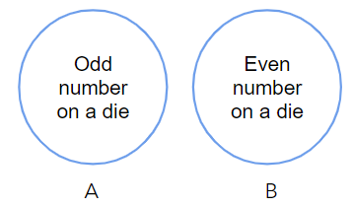
Independence and mutually exclusive events
If A and B are independent events with P(A) and P(B) both non-zero, then A and B cannot be mutually exclusive
If A and B are mutually exclusive with P(A) and P(B) both non-zero, then A and B cannot be independent i.e A and B are dependent

Slide 34
Mutually exclusive
Question:
A card is drawn from a pack of 52 cards. Let events A and B be:
A: Occurrence of a club card
B: Occurrence of a red ace card
Are the events A and B mutually exclusive? Why.
Solution:
The club card is a black card and event B is the occurrence of a red card. Implies, A ∩ B is empty. Thus the events A and B mutually exclusive.

Slide 35
Conditional Probability

Slide 36
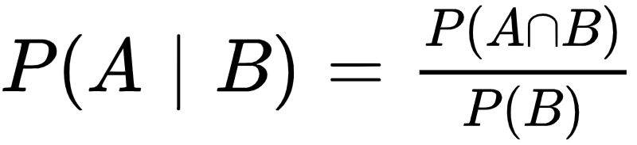
Conditional Probability
The conditional probability of an event A is the probability that the event will occur given the knowledge that an event B has already occurred
It is denoted by,

Slide 37
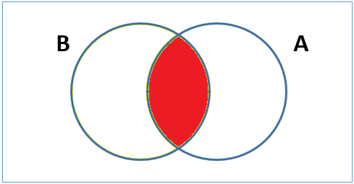
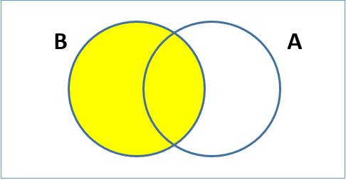
Conditional Probability
The conditional probability of an event A is the probability that the event will occur given the knowledge that an event B has already occurred
It is denoted by,

Slide 38

Conditional probability
Question:
A pair of fair dice is rolled. If the product of numbers that appear is 6, find the probability that the second die shows an even number?

Slide 39
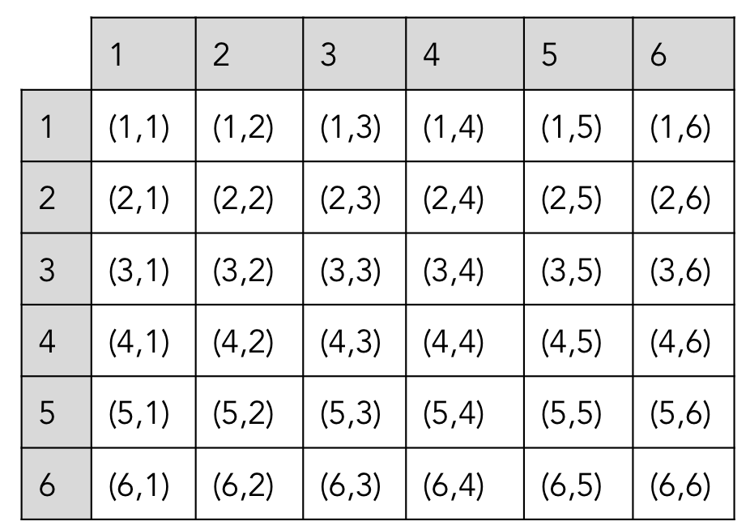
Conditional probability
First Dice
Solution:
Let A: the event of getting the product as 6
The ways A can occur: {(1,6), (2,3), (3,2), (6,1)}
Let B: the event that the second die shows an even number
The ways B can occur: {(1,2), (1,4), (1,6), (2,2), (2,4), (2,6), (3,2), (3,4), (3,6), (4,2), (4,4), (4,6), (5,2), (5,4), (5,6), (6,2), (6,4), (6,6)}
Thus, the event that product of the die is 6 and number 2 appears on the dice is A ∩ B.
A ∩ B = {(1,6), (3,2)}
The total number of samples is 36.
Second Dice

Slide 40
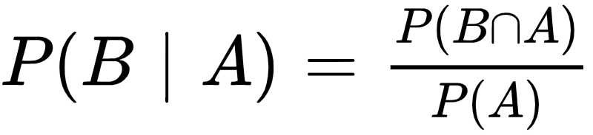
Conditional probability
Solution:
The required probability is

Slide 41
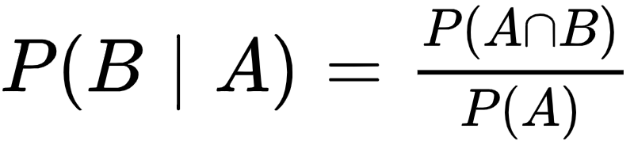
Let A and B be two events:
Addition theorem:
Multiplication theorem:

Slide 42
Bayes’ theorem
Conditional probability is the likelihood of an event given that another event has occurred
Bayes theorem provides a way to update the probability based on the new information
It is completely based on the conditional probability
Also known as Bayes’ Rule or Bayes’ law

Slide 43
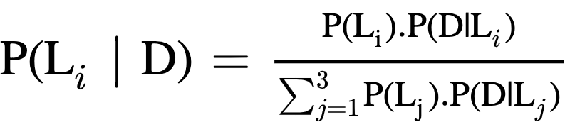

Bayes’ theorem
Suppose L₁, L₂ and L₃ are the production lines of an industry and D is the event that the article manufactured is defective. Given the article is defective, we need to find the probability that it was produced on which line.
Which production line do I belong to?
Defective Item

Slide 44
Bayes’ theorem
Defective Item
Not Defective Item
What is the probability that the defective item chosen was from the production line 1?
Production Line 1
Production Line 2
Production Line 3
P(L₁) = 0.3
P(L₂) = 0.4
P(L₃) = 0.3

Slide 45
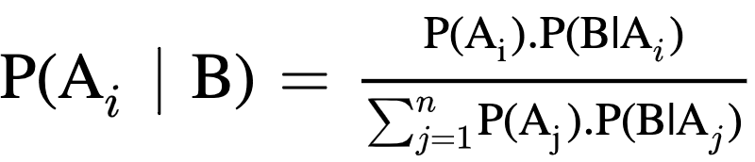

Bayes’ theorem
Suppose events A₁, A₂, …, A_{n} form a partition on a sample space Ω of a random experiment and B is any other event such that P(B) > 0 defined on Ω, then
Prior Probabilities
Likelihood
Posterior Probabilities
Evidence

Slide 46
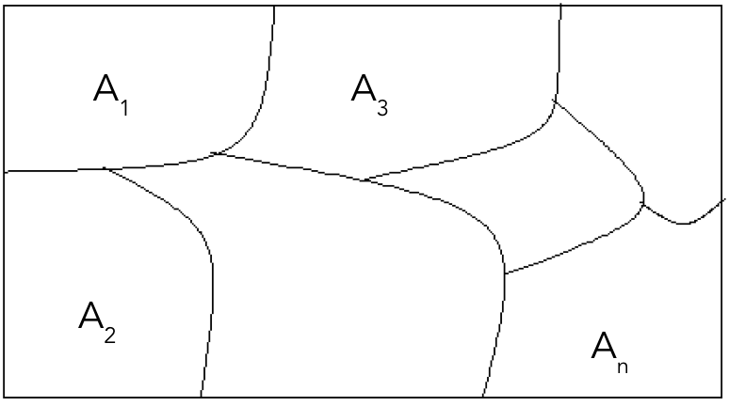
Partition of a sample space
The events A₁, A₂, …, A_{n} defined on a sample space Ω are said to form a partition if and only if
A_{i} ⋂ A_{j} = Φ for all i and j; i ≠ j (mutually exclusive)
⋃ A_{i} = Ω (exhaustive)
n
i=1

Slide 47
Prior probabilities
Consider three production lines L₁, L₂, L₃ manufacturing the same finished articles
From the past experience, it is seen that the chance of selecting a production line is 0.3, 0.4, 0.3 respectively
These probabilities are called the prior probabilities

Slide 48
Posterior probabilities
Consider three production lines L₁, L₂, L₃ manufacturing the same finished articles
An article is chosen at random and is found to be defective
The knowledge of the probability that the defective article is produced by L₁, L₂ or L₃ will help in improving the quality of the product line, i.e. P(L₁| defective article)
These probabilities are called the posterior probabilities
The probability is computed after the production line manufactures the articles

Slide 49
Likelihood
Consider three production lines L₁, L₂, L₃ manufacturing the same finished articles
Likelihood is the conditional probability that the article produced is defective given it is produced on one of the lines L₁, L₂, L₃. i.e. P(defective article | L₁)
It specifies the chance of producing a defective article of the given production line

Slide 50
Evidence
Event D is that the article selected is defective, which is not used in the calculation of the prior probability
In our example, the evidence is the probability of selecting a defective article produced on any of the production lines L₁, L₂ or L₃
It is also known as marginal probability

Slide 51
Bayes’ theorem
Question:
In an armament production station, the explosion can occur due to short circuit, fault in the machinery, negligence of workers. From experience, the chances of these causes are 0.1, 0.3, 0.6 respectively. The chief engineer feels that an explosion can occur with probability:
0.3 if there is a short circuit
0.2 if there is a fault in the machinery
0.25 if the workers are negligent
Given that an explosion has occurred, determine the most likely cause of it?

Slide 52
Bayes’ theorem
Solution:
Let the events be defined as
A₁: the explosion can occur due to short circuit
A₂: the explosion can occur due to fault in the machinery
A₃: the explosion can occur due to negligence of workers
The prior probabilities are
P(A₁) = 0.1, P(A₂) = 0.3, P(A₃) = 0.6

Slide 53
Bayes’ theorem
Solution:
Let B be the event there is an explosion.
Thus the probabilities are
P(there is an explosion| there is a short circuit) = P(B | A₁) = 0.3
P(there is an explosion| there is a fault in the machinery) = P(B | A₂) = 0.2
P(there is an explosion| the workers are negligent) = P(B | A₃) = 0.25

Slide 54

Bayes’ theorem
Solution:
To find: the most likely cause of it given that an explosion has occurred
Thus, using the bayes theorem, to compute the probability that there is a short circuit given an explosion has occurred is computed as

Slide 55
Bayes’ theorem
Solution:
Similarly,

Slide 56
Bayes’ theorem
Solution:
Thus, we have
P( there is a short circuit | there is an explosion) = P(A₁ | B ) = 0.125
P( there is a fault in the machinery| there is an explosion) = P(A₂ | B ) = 0.25
P( the workers are negligent| there is an explosion) = P(A₃ | B ) = 0.625
Comparing the probabilities, P(A₃ | B ) has highest probability. It implies that the negligence of workers is the most likely cause of an explosion in the factory.

Slide 57
Summary
Terminologies | Meaning
Prior Probability | Probability of the event A (P(A))
Posterior Probability | Conditional probability of the event A given event B has occurred (P(A|B))
Likelihood | Conditional probability of the event B given event A has occurred (P(B|A))
Evidence | Probability of the event B (P(B))

